Slide 1
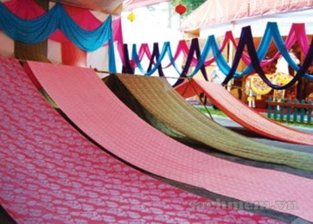
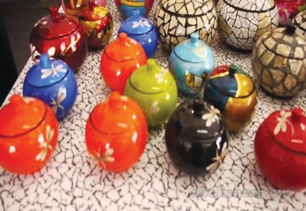
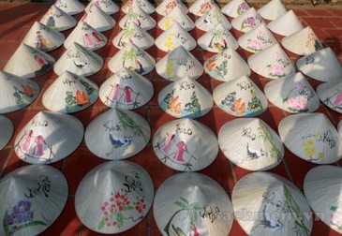
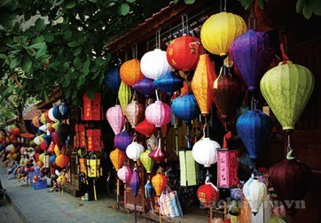
silk
lacquerware
/ˈlækəweə(r)/
conical hats
lanterns

Slide 2
Unit 1:
LOCAL ENVIRONMENT
Lesson 1: Getting started:
A visit to a traditional craft village

Slide 3
1. Who and what can you see in the picture?
2. Where are they?
3. What do you think the people in the picture are talking about?

Slide 4
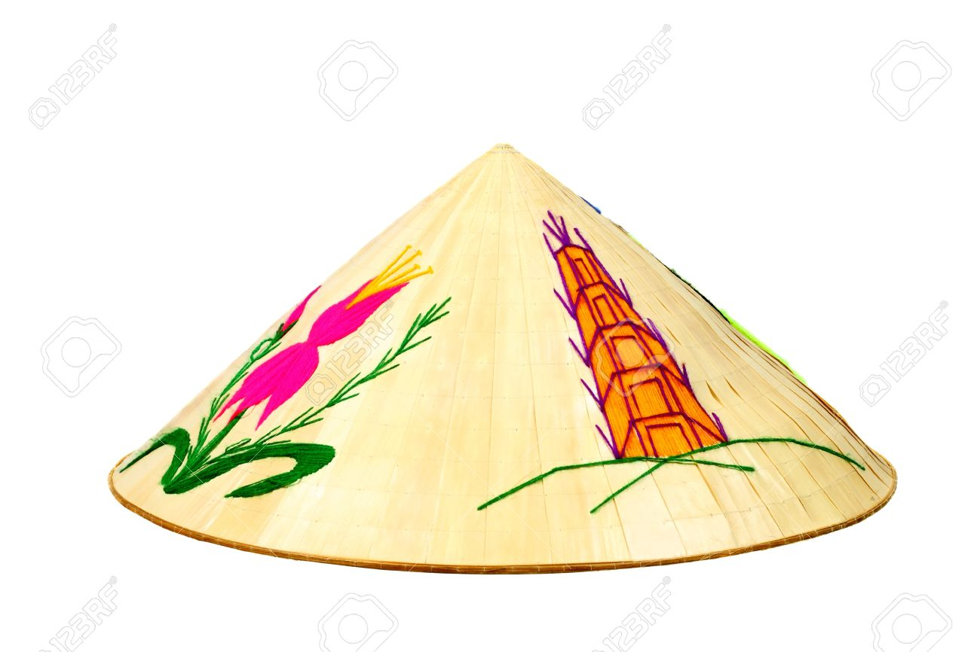
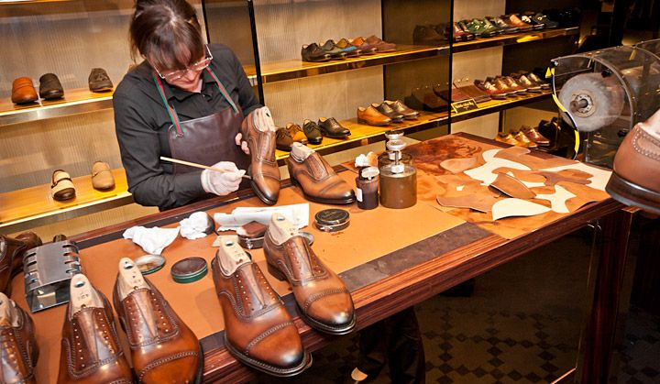
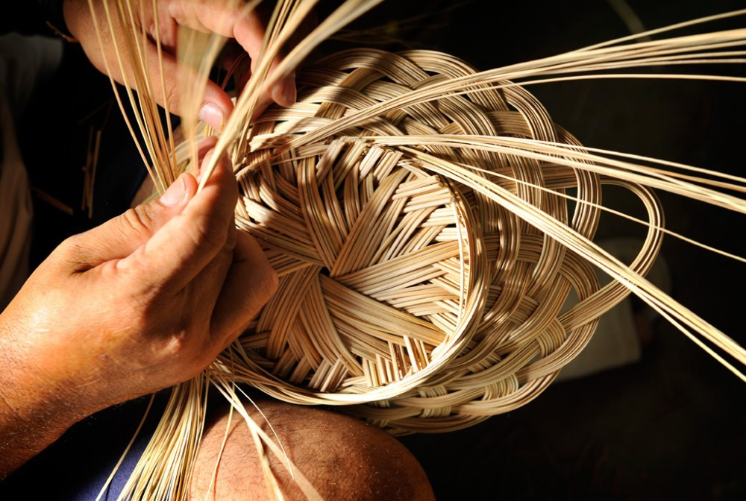
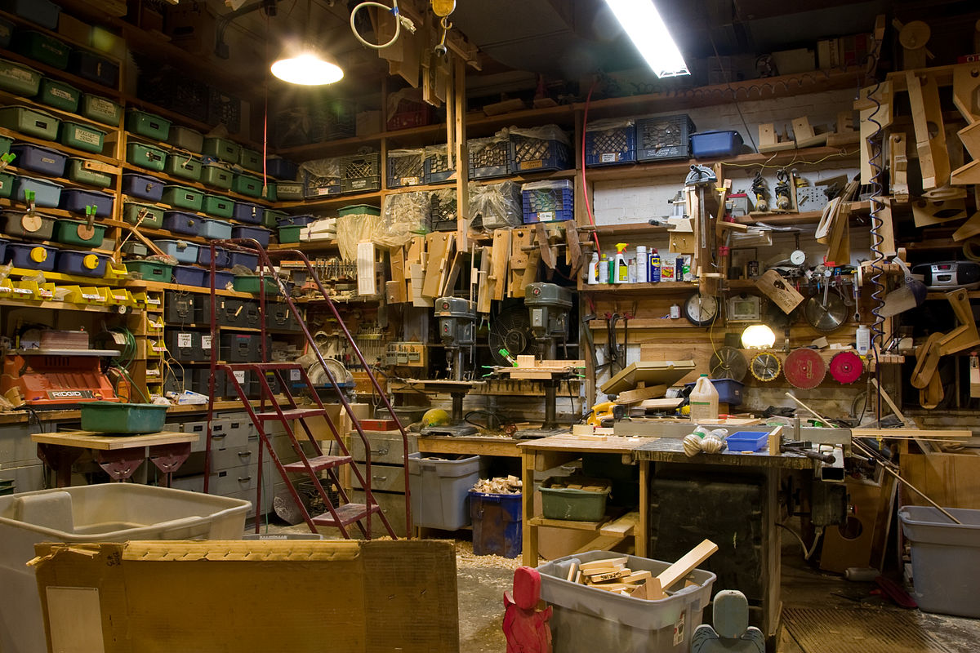
Vocabulary:
artisan /ˌɑːtɪˈzæn/ (n)
thợ thủ công
set up (ph.v)
xây dựng
workshop /ˈwɜːkʃɒp/
xưởng/công xưởng
conical hat /ˈkɒnɪkl hæt/
nón lá
handicrafts/ˈhændikrɑːft/
sản phẩm thủ công
take over (ph.v)
tiếp quản

Slide 5
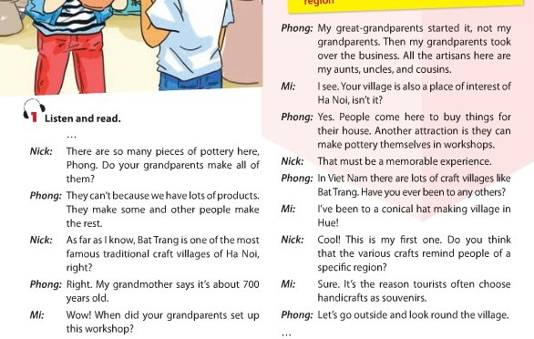
1. Listen and read:

Slide 6
1.a. Can you find a word/phrase that means?
1. a thing which is skillfully made with your hands
2. start something (a business, an organization, etc.)
3. take control of something (a business, an organization, etc.)
4. people who do skilled work, making things with their hands
craft
set up
take over
artisans

Slide 7
1.a. Can you find a word/phrase that means?
5. an interesting or enjoyable place to go or thing to do
6. a particular place
7. make someone remember or think about something
8. walk around a place to see what is there
attraction
specific region
remind
look round

Slide 8
1.b. Answer the following questions?
1. Where are Nick, Mi, and Phong?
2. How old is the village?
3. Who started Phong’s family workshop?
4. Why is the village a place of interest in Ha Noi?
5. Where is the craft village that Mi visited?
6. Why do tourists like to buy handicrafts as souvenirs?

Slide 9
1.b. Answer the following questions?
1. Where are Nick, Mi, and Phong?
They are at Phong’s grandparents’ workshop in Bat Trang.
2. How old is the village?
It is about 700 years old.
3. Who started Phong’s family workshop?
His great-grandparents did.
4. Why is the village a place of interest in Ha Noi?
Because people can buy things for their house and make pottery themselves there.
5. Where is the craft village that Mi visited?
It is in Hue.
6. Why do tourists like to buy handicrafts as souvenirs?
Because the handicrafts remind them of a specific region.

Slide 10
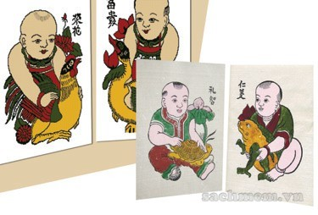
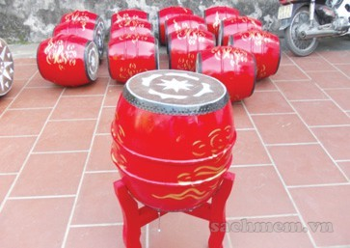
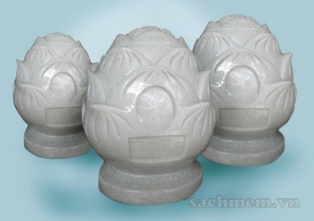
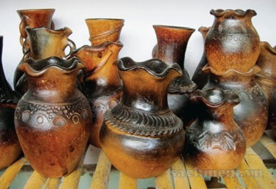
2. Write the name of each traditional handicraft in the box under the picture.
A. paintings
B. drums
C. marble sculptures
D. pottery

Slide 11
E.silk
F. lacquerware
/ˈlækəweə(r)/
G. conical hats
H. lanterns

Slide 12
3. Complete the sentences with the words/ phrases from 2
conical hat
1. The birthplace of the famous bai tho ……………….
is Tay Ho village in Hue.
2. If you go to Hoi An on the 15th of each lunar month, you can enjoy the lights of many beautiful ……………………….
3. Van Phuc village in Ha Noi produces different types of ……………. products such as cloth, scarves, ties, and dresses.
lanterns
silk

Slide 13
3. Complete the sentences with the words/ phrases from 2
4. On the Tet holiday, many Hanoians go to Dong Ho village to buy folk……………….. .
5. …………… products of Bau Truc, such as pots and vases, have the natural colours typical of Champa culture in Ninh Thuan.
6. Going to Non Nuoc marble village in Da Nang, we’re impressed by a wide variety of …………………………from Buddha statues to bracelets.
paintings
Pottery
marble sculptures

Slide 14
4. Quiz: WHAT IS THE PLACE OF INTERESTS?
a. Work in pairs to do the quiz.
1. People go to this area to walk, play, and relax.
2. It is a place where objects of artistic, cultural, historical, of scientific interest are kept and shown.
3. People go to this place to see animals.
4. It is an area of sand, or small stones, beside the sea or a lake.
5. It is a beautiful and famous place in the countryside.
1.park
2. museum
3. zoo
4. beach
5. beauty spot

Slide 15
- Learn by heart the new words - Prepare for the next lesson
Homework

